Slide 1
STUDENT INFORMATION MANAGEMENT SYSTEM (SIMS) USING PHP
PAAVAI ENGINEERING COLLEGE(AUTONOMOUS) PACHAL, NAMAKKAL-637 018
GUIDE NAME
Mrs.J.VELUMANI,M.E.,(Ph.D).
Associate Professor Department of CSE
PROJECT MEMBERS
ADITYA PAREEK.V (16104001)
DHINA.S (16104024)
GOBIPRASATH.N (16104029)

Slide 2
ABSTRACT
This project can be used by colleges to maintain the records of students easily for placement purpose. This project also contain faculty details, students details, various academic and placement notifications to the staff and students updated by the administration. This project mainly explains the various actions related to student details. This project shows some ease in adding, editing and deleting the student details and it consume less time. This system is focused on recording and updating the student details. It can also facilitate to explore the placement updates for the students with several core companies.

Slide 3
OBJECTIVES
The objectives are
Giving online interface for faculty members.
Expanding the effectiveness of college record administration.
Abatement time needed to access and convey students records.
Monitoring the academic performance of the students

Slide 4
REQUIREMENTS
SOFTWARE REQUIREMENTS
Operating system : Platform Independent
Coding Language : HTML, CSS, JS, PHP
Database : My-SQL
Server : Apache
IDE : Notepad++

Slide 5
EXISTING SYSTEM
In the existing system the students will enter their data enter manually through registration.
Internal assessments marks, attendance, exam timetable will be displayed to the students.
DISADVANTAGES OF EXISTING SYSTEM
Through students registration incorrect details may appear. (Eg: 79.6% will round off the percentage as 80%)
There is no efficient technique to safe guard the users of phishing websites.

Slide 6
LITERATURE SURVEY
TITLE&AUTHOR | ADVANTAGE | DISADVANATGE
Development of Student Information System N.M.Z.Hashim, S.N.K.S.Mohamed (2013) | Lot of man power and resource time is saved from an admin perspective. | Data can’t be filtered as per the need.
Web Based Student Information Management System S.R.Bharamagoudar, Geeta R.B., S.G.Totad (2013) | Redundant human errors will be reduced. | Unauthorized person can easily register.
A Framework for Web Based Student Record Management System using PHP Saurabh Walia1, Satinderjit Kaur Gill(2014) | Closer interaction between student and staff. | Consist of single module UI
Contd…

Slide 7
LITERATURE SURVEY
TITLE&AUTHOR | ADVANTAGES | DISADVANTAGES
Student Information Management System Manisha K, Alekhya K, Manikanta T, Ramya B, Sai Kumar S.(2016) | Hassle free recruitment or management for placement companies | Lack of Student personal details.
Student Management System – A Survey Krithi P, Dr M Ramakrishna(2017) | Single source of information for students. | Filtering students according to the need of the recruiting companies is difficult.

Slide 8
PROPOSED SYSTEM
In proposed system will have the provision for adding the details of the students by staff.
It is easy to create, edit and modify the student details and delete a student when it found unnecessary.
In this placement updates will be given and academic details can viewed for each semester.

Slide 9
ADVANTAGES OF THE PROPOSED SYSTEM
Our proposed system has several advantages
Incorrect data can be reduced
Monitoring academic performance
Search facility
Placement notification

Slide 10
MODULES
User Module Admin has the authority to add department and staff details and gives placement updates regularly.The students details can be viewed by admin.
Staff Module
Staff menu has authority to add students and academic details after verifying with the students semester wise.

Slide 11
DATA FLOW DIAGRAM
START
ADMIN HOME
STAFF HOME
Login fails
LOGIN
LOGIN
Login Success
Login Success
STAFF
STUDENT
CGPA
STUDENT
CGPA

Slide 12
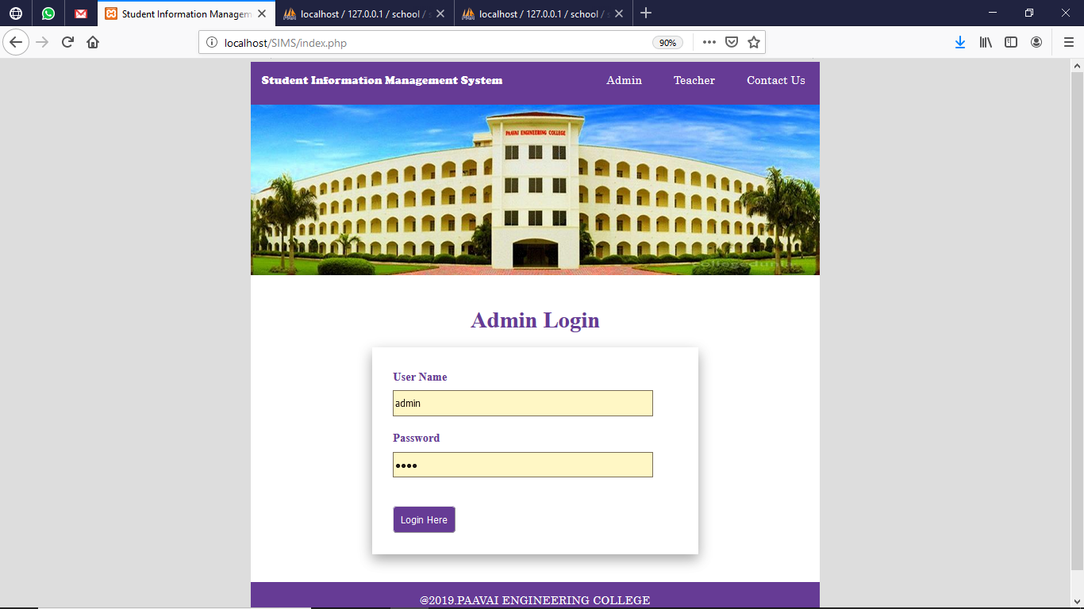
ADMIN LOGIN

Slide 13
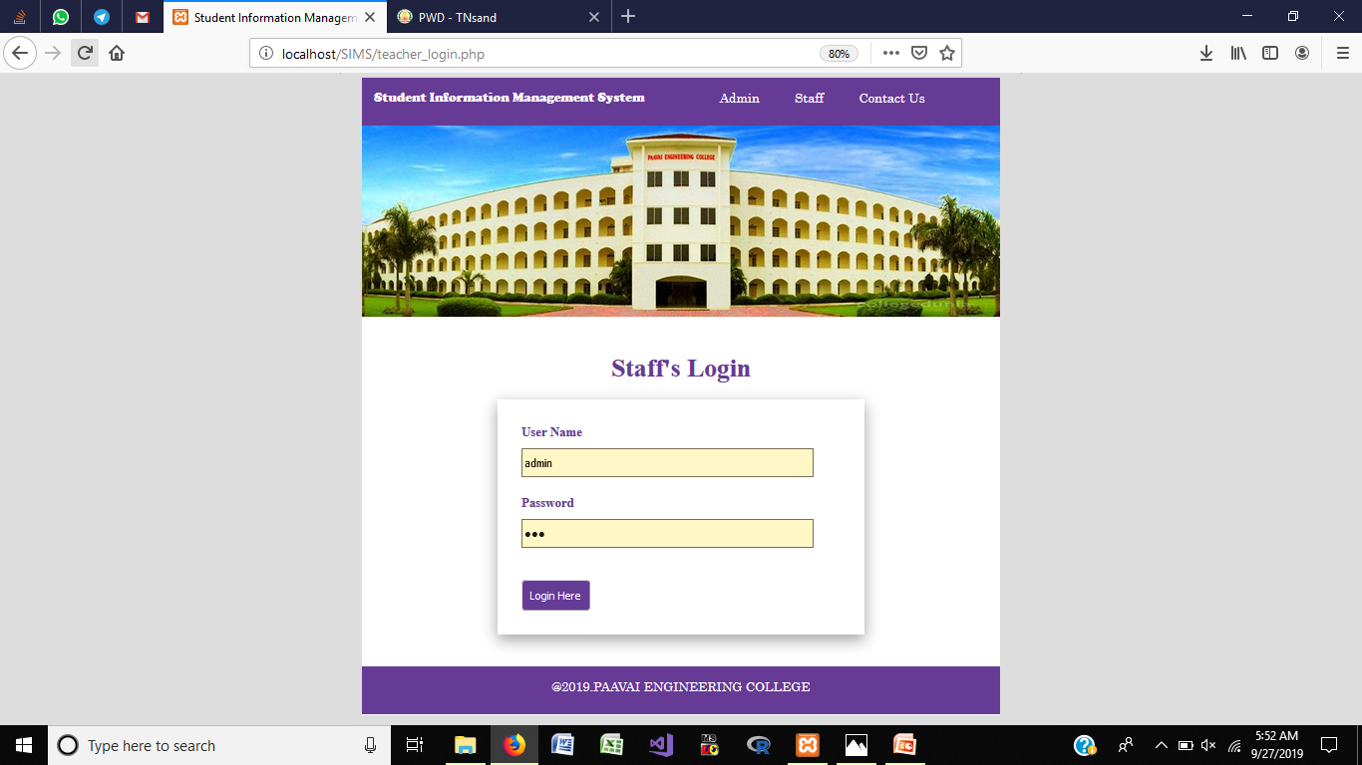
STAFF LOGIN

Slide 14
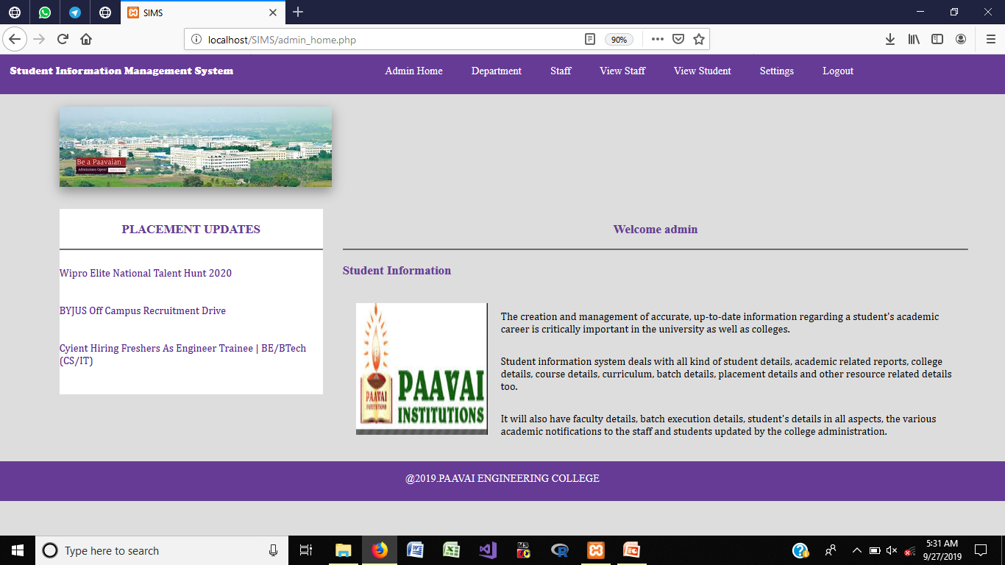
ADMIN HOME PAGE

Slide 15
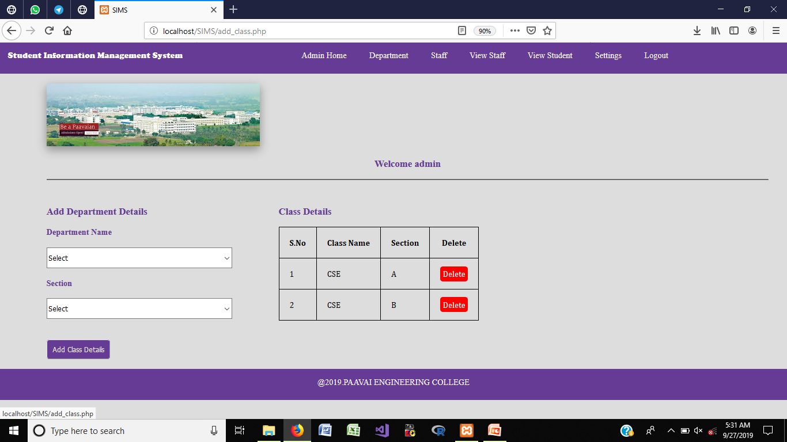
ADD DEPARTMENT

Slide 16
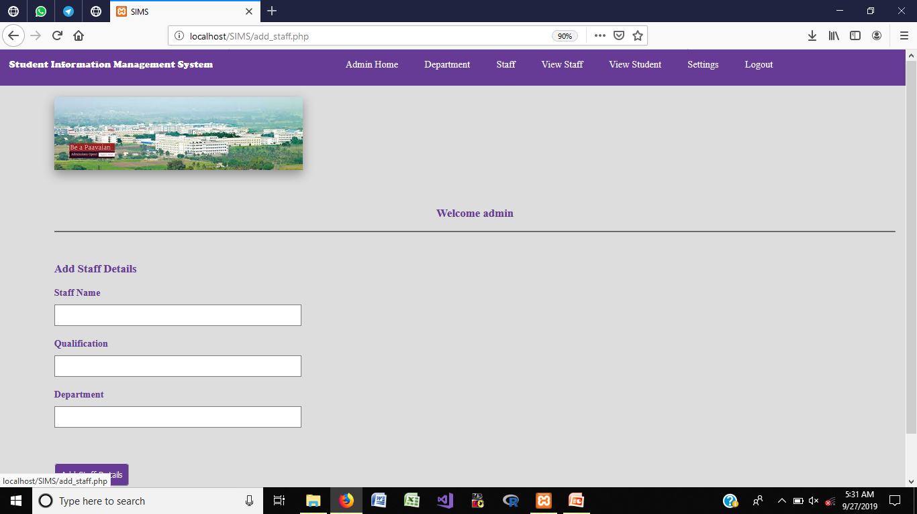
ADD STAFF DETAILS

Slide 17
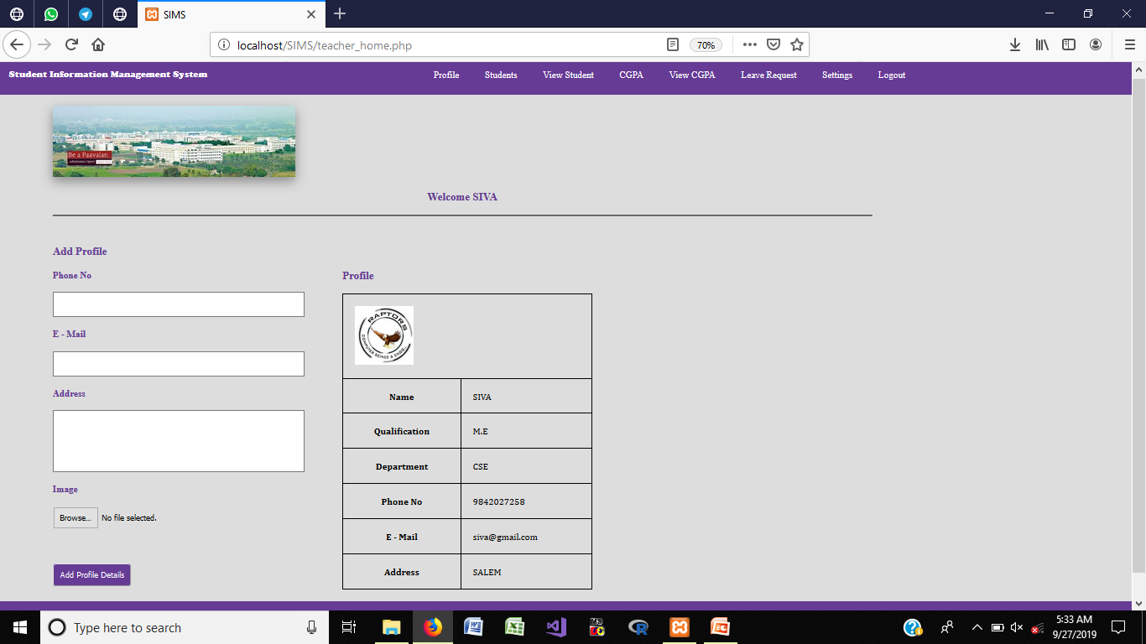
STAFF PROFILE

Slide 18
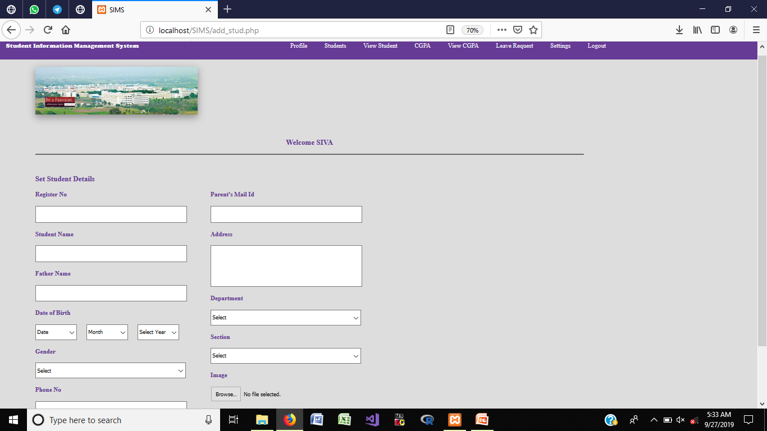
ADD STUDENTS DEATILS

Slide 19
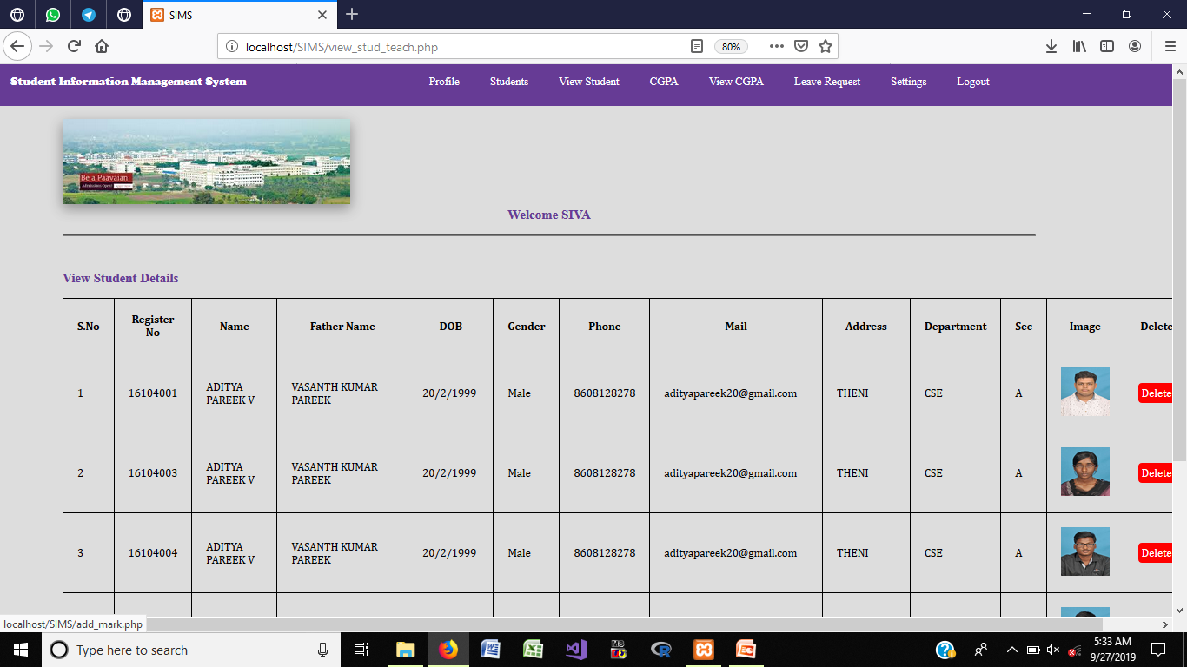
VIEW STUDENTS

Slide 20
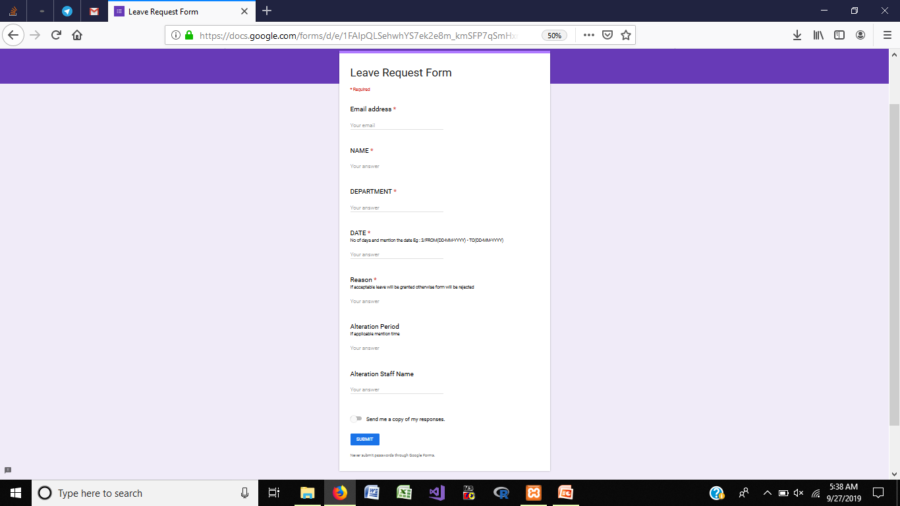
LEAVE REQUEST

Slide 21
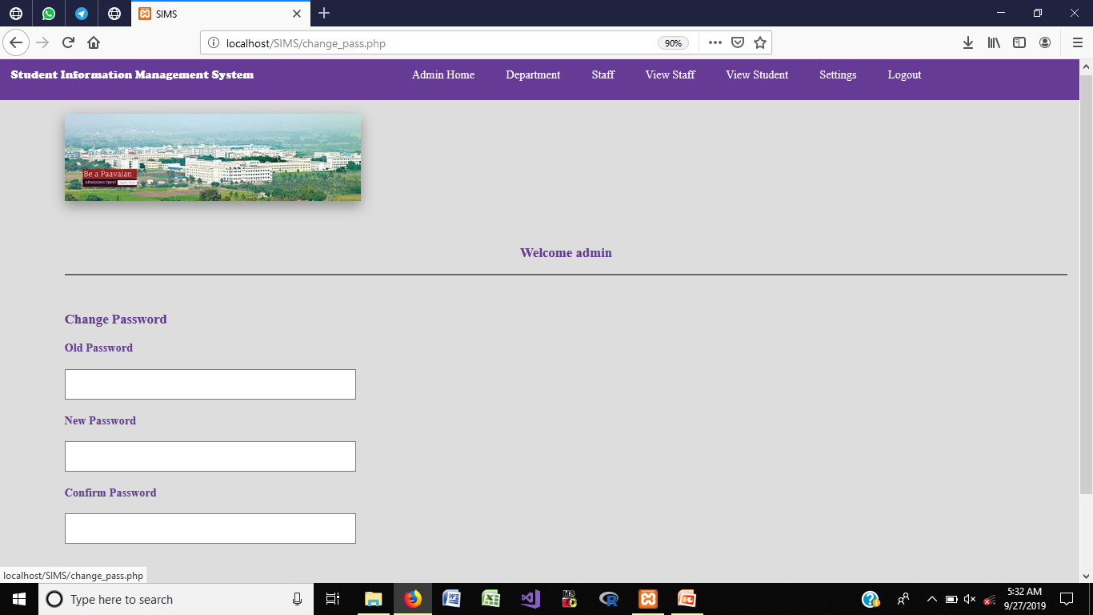
CHANGE PASSWORD

Slide 22
CONCLUSION
Data can be accessed any time.
Monitored and controlled easily.
Incorrect details of students can be avoided.
It provides accurate information always.

Slide 23
FUTURE ENHANCEMENT
It can be implemented with additional student data with the strength of whole institution.
It is very easy to get the necessary information without time delay.
It can be enhanced to get daily report on attendance, internal assessments, fees management to their parents.
Information about student’s academic performance can be send to their parents via SMS and mail.

Slide 24
REFERENCES
[1] N.M.Z.Hashim, S.N.K.S.Mohamed ”Development of Student Information System” International Journal of Science and Research (IJSR), India Online ISSN: 2319-7064, Vol. 2, Issue 8, August 2013..
[2] S.R.Bharamagoudar, Geeta R.B., S.G.Totad “Web Based Student Information Management System” International Journal of Advanced Research in Computer and Communication Engineering Vol. 2, Issue 6, June 2013.
[3] Saurabh Walia1, Satinderjit Kaur Gill “A Framework for Web Based Student Record Management System using PHP” International Journal of Computer Science and Mobile Computing (IJCSMC), Vol. 3, Issue. 8, August 2014.
Contd…

Slide 25
REFERENCES
[4] Manisha K, Alekhya K, T Manikanta, B Ramya, S. Sai Kumar “Student Information Management System” International Journal of Advanced Research in Computer Science and Software Engineering,Volume 6, Issue 3, March 2016.
[5] Krithi P, Dr M Ramakrishna “Student Management System – A Survey” International Research Journal of Computer Science (IRJCS) Issue 05, Volume 4 (May 2017).

